Slide 1
CMR Institution Of Technology Bangalore
WELCOME TO MY PRESENTATION
Of PROJECT REPORT ON
“QUIZ GAME”
Submitted by : P.VISHNUPRIYA
USN : 1CR20MC116
Under the guidance of : Varsha Pawar

Slide 2
O
n
L
i
n
e
QUIZ GAME

Slide 3
INTRODUCTION
The project “QUIZ GAME”. It is web based application program that has general questions with time limit and it also calculate scores of each correct answer. It is good for students of every age group it helps in increasing general knowledge about world, sports, computer etc .
Before start of the quiz, the rules and regulations are displayed that includes description of the time limit, number of questions to be answered and scoring methods. Quiz is started by displaying one question with four options . If the answer is correct, score is incremented by one and no negative marks for wrong answers. If the time exceeds 20secs next question will come automatically and final score will be displayed in the score page and updated in the database with user name.

Slide 4
Advantages
1
Less time consuming .
2
Result will be very precise and accurate .
3
It is very secure .
4
The result can be seen immediately .

Slide 5
Forms
1
1. Main Form
2. Login Form
3. Question and Result Form
2
3

Slide 6
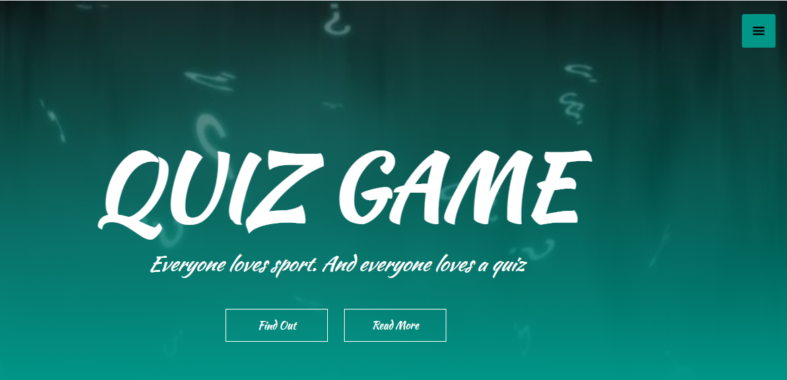
Main Form

Slide 7
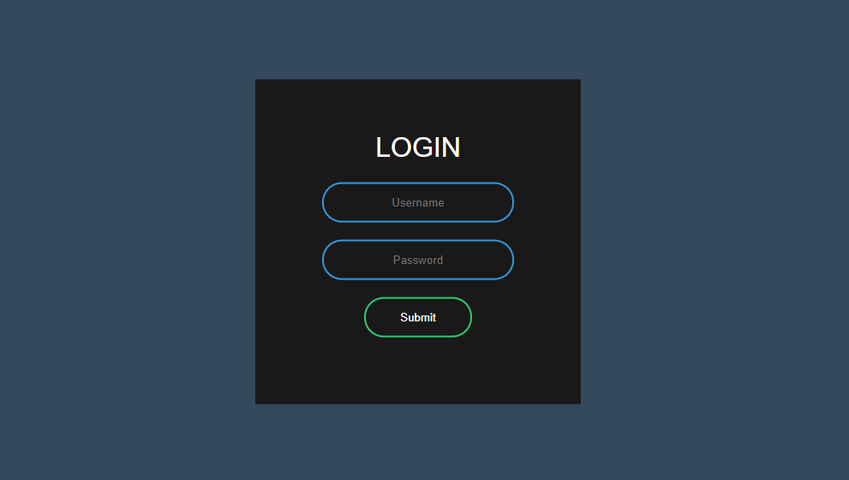
Login Form

Slide 8
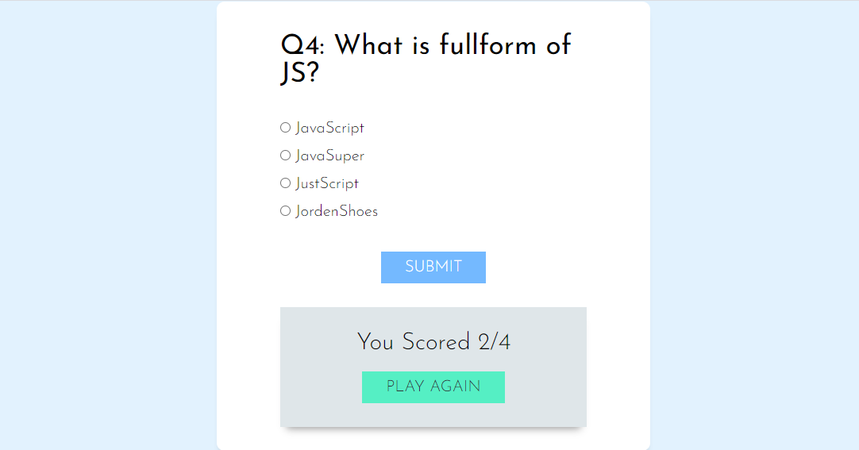
Question and Result Form

Slide 9
System Requirement specifications
Software
Frontend : HTML,CSS,JAVASCRIPT
Backend : MY SQL
Platform : Windows10

Slide 10
System Requirement specifications
Hardware
The project is executed in the system with the following features
Processor : Intel Core i5
RAM : 8GB
Hard Disk : 1TB
However, the program can be executed in the system with
following features
Processor : Intel Dual Core
RAM : 1GB
Hard Disk : 500 GB

Slide 11
Conclusion
The project is completed successfully as per the expectations. The project has covered almost all the user requirements. Further requirements and improvements can be easily done since the coding is mainly structured or modular in nature.
Any type of queries can be resolved using the software. It is very helpful for the students as a part of testing their knowledge and understanding the pattern of question paper.
The project and its implementation has contributed a lot to our knowledge that has proved to be a value addition for us. We take this opportunity to express our sense of indebtedness and gratitude to all those people who helped me in completing this project.

Slide 12
Thank You
Everyone Loves sports , and Everyone loves Quiz.

